Slide 1
e-Tendering
Internal Guide:
Miss. Nirvruti Patel
Faculty of CE/IT Dept.
UVPCE,Kherva.
External Guide:
Mr. Chandrashekhar Dash,
Project Guide,
CMC Ltd., Ahmedabad.
GROUP MEMBER:
Rushiraj Brahmbhatt(11012011004)
Naitik Datta(11012011007)

Slide 2
Introduction
Tender process is determined by the organization requesting the tender will determine the type of tender that will be used, as well as what will be involved in the tender process.
Request for tender is prepared by the request for tender outlines what is required, the contractual requirements and how you should respond. The value, complexity and business category determine how tenders are invited.
Suppliers respond by first obtain all relevant documentation, and then:
Attend any pre tender briefing sessions being conducted
Clarify any uncertainties
Plan your response
Prepare your response
Submit your response in the right format, on time and at the right location.

Slide 3
Introduction Cont..
Evaluation and selection: each tender will be checked for compliance, and if compliant, then evaluated against the criteria specified in the tender documentation. The tender that offers best value for money will win the business.
Notification and debriefing: when a contract has been awarded, the successful tenderer will be advised in writing of the outcome. Unsuccessful tenderers are also advised and offered a debriefing interview.
Contracts established and managed: generally a formal agreement will be required between the successful tenderer and the relevant agency.

Slide 4
What is e-tendering..??
E Tendering is a process of carrying out entire Tendering Cycle Online including submission of Price Bid such that Efficiency, Economy, Speed of Internet can be harnessed.
E Tendering Cycle can be broken in Key Modules.
1) Tender Notice Creation | 7) Tender Storage & Opening
2) Tender Promotion | 8) Tender Evaluation
3) Tender Document | 9) Negotiation
4) Pre Bid Meeting | 10) Tender Award
5) Bid Submission | 11) Vendor Registration & Rating
6) Payment Gateway | 12) Tender Audit & Storage

Slide 5
Benefits of Tendering Authority
Completely Automated Process
Shortens Procurement Cycle
Economical and Environment Friendly
Greater Transparency
Improvement in work culture in the departments
System aided Evaluation process
On the fly reports/comparatives statement
Minimize Human errors
Minimal Storage Spaces
Change in Perception – Progressive Organization
Lesser hassle of communication and administration

Slide 6
Benefits to Suppliers/Contractors
Anytime & Anywhere Bidding
Fair, Free and Fearless participation for vendors.
No dependence on Newspaper, Courier, Banks,…
Zero Administrative hassles
Can carry out all activities from any computer
Economical – saving on Traveling cost
Reduces efforts & cost of bidding
No tenders can be missed because of distance
Can submit bid on last minute

Slide 7
Manual Vs E-Tendering System
Manual Tendering System
Longer Procurement Cycle
Expensive
Paper Based Procurement
Restricted Mobility
No work on Holidays
Prone to Human errors
Content not sharable
Physical Security
Wastage of space to store bids
Not retrievable
Ideal till 2003
E - Tendering System
Shorter Procurement Cycle
Economical – Fixed Cost
Environmentally Friendly
Anytime – Anywhere Bidding
Bidding possible on Holidays
Automated & Accurate process
Shareable Content
Foolproof Security
Lifelong storage on CD
One click access to bids
For year 2004 & Beyond

Slide 8
Strategic Alliance
System Requirements
OS – Microsoft /Linux.
Back End – MYSQL.
Front End – Sun JAVA , Hibernate.
IDE-Google Chrome

Slide 9
Time Based Access
No activity can be carried out before due date & Time for e.g.
Tender cannot be opened even by authorized User before due date
Server Time cannot be tampered as it is mapped to National Standard Time Server.

Slide 10
Time Stamping
Key processes are time stamped
Tender cannot be proponed
Tenders cannot be submitted after due date and time
Tender cannot be opened before due date and time.
All processes can be time stamped.

Slide 11
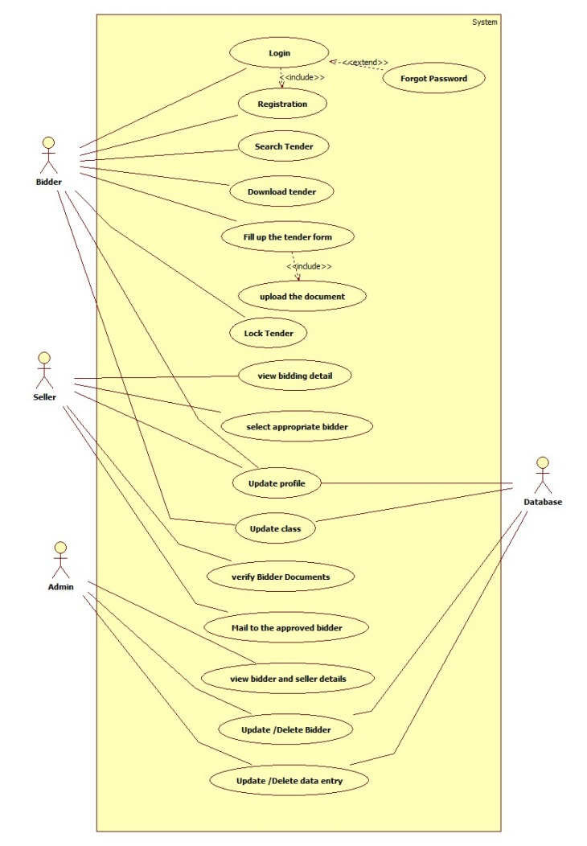
Use case diagram

Slide 12
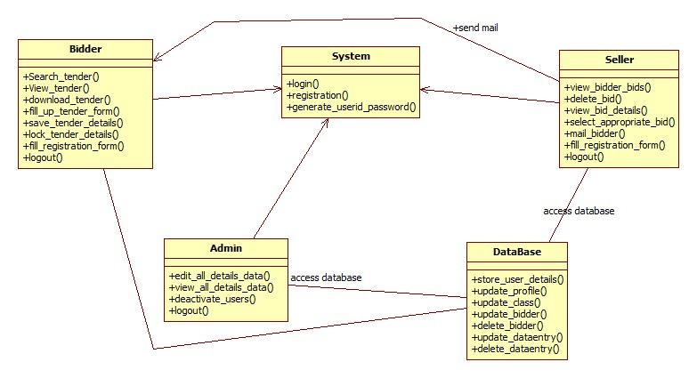
Class diagram

Slide 13
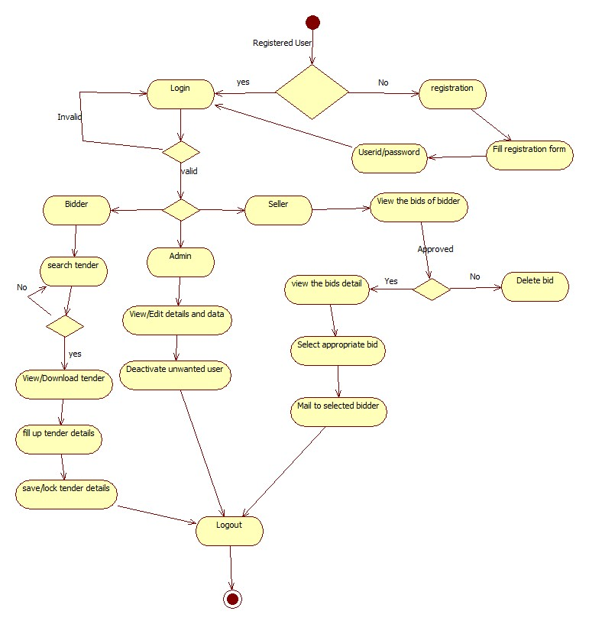
Activity diagram

Slide 14
Data dictionary
TABLE-1
NAME | TYPE
ID | INT
FIRST NAME | VARCHAR
LAST NAME | VARCHAR
E-MAIL | VARCHAR
USERNAME | VARCHAR
PASSWORD | VARCHAR
PHONE | INT
CITY | VARCHAR
TYPE | VARCHAR
DESIGNATION | VARCHAR
DEPARTMENT | VARCHAR

Slide 15
TABLE-2
NAME | TYPE
COMPANY NAME | VARCHAR
PAN NO | VARCHAR
INCOME TAX CERTIFICATE | BLOB
ESTABLISHED DATE | DATE
LICENCE | DATE
SOLVENCY | BLOB
ADDRESS | VARCHAR
REGISTRATION NO | VARCHAR
CLASS | VARCHAR

Slide 16
TABLE-3
NAME | TYPE
SR NO | INT
DEPARTMENT | VARCHAR
TENDER | BLOB
TABLE-4
NAME | TYPE
ID | INT
TENDER NAME | VARCHAR
COST | INT
PERIOD | VARCHAR
DEPOSIT AMOUUNT | BLOB
TENDER FEE | BLOB
DOCS | BLOB
STATUS | VARCHAR

